Slide 1
rempstone
adventure camp

Slide 2
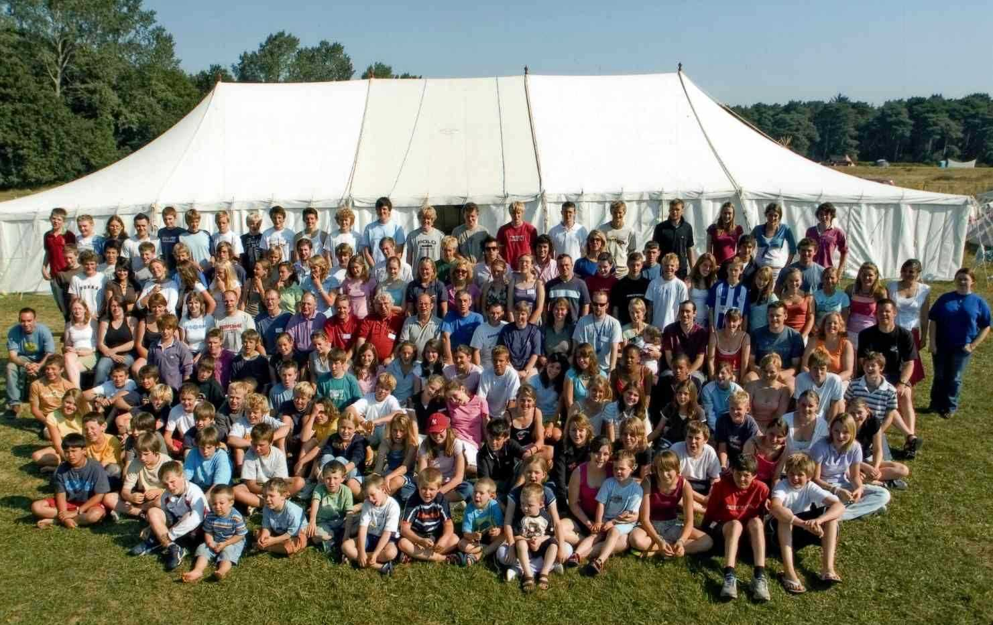
rempstone
adventure camp

Slide 3
rempstone
adventure camp
Rempstone Adventure Camp is an exciting multi-activity adventure holiday for boys and girls from years 6 to 10. The purpose of the camp is to have fun and we do!
Rempstone Adventure Camp is a Christian organisation and encourages Christian values but you do not have to be a Christian to come.

Slide 4
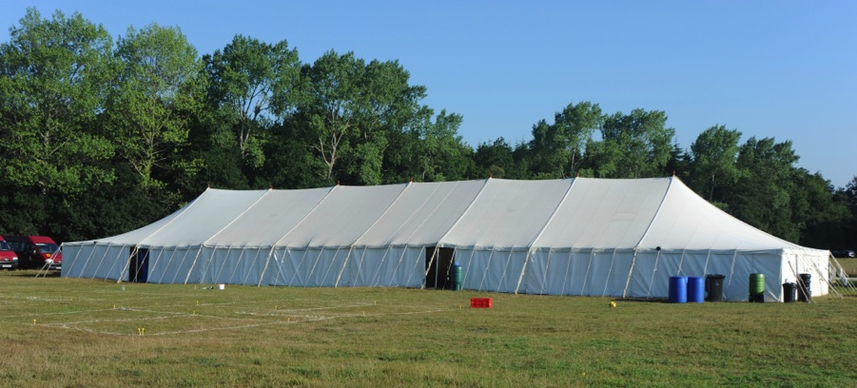
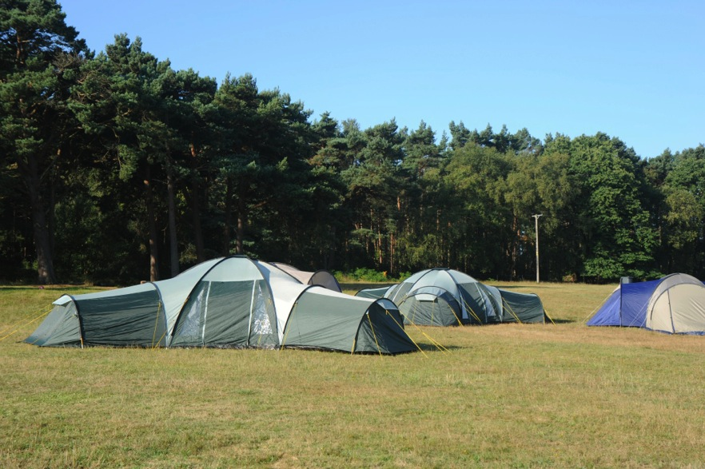
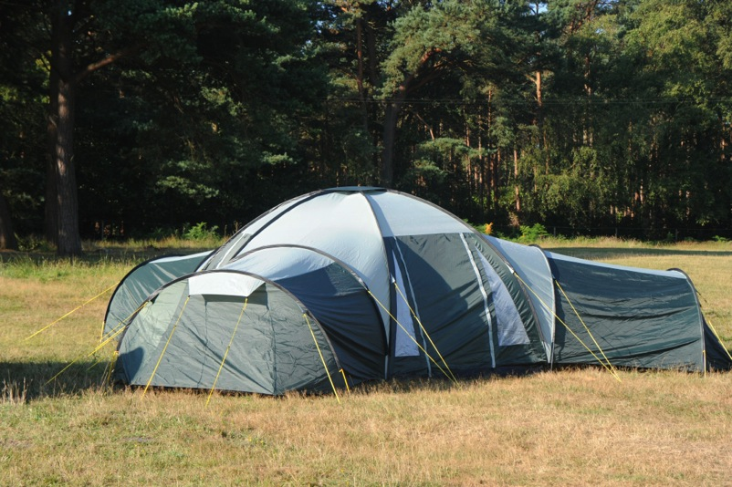
rempstone
adventure camp

Slide 5
rempstone
adventure camp
Our sheltered site close to the Burnbake Ropes Course has plenty of space for on-site games and the surrounding countryside and beaches are ideal for all the other activities.
Campers live in large comfortable tents under the guidance of a tent leader. The tents are divided into two or three person rooms. We have a massive marquee for meals and meetings.

Slide 6
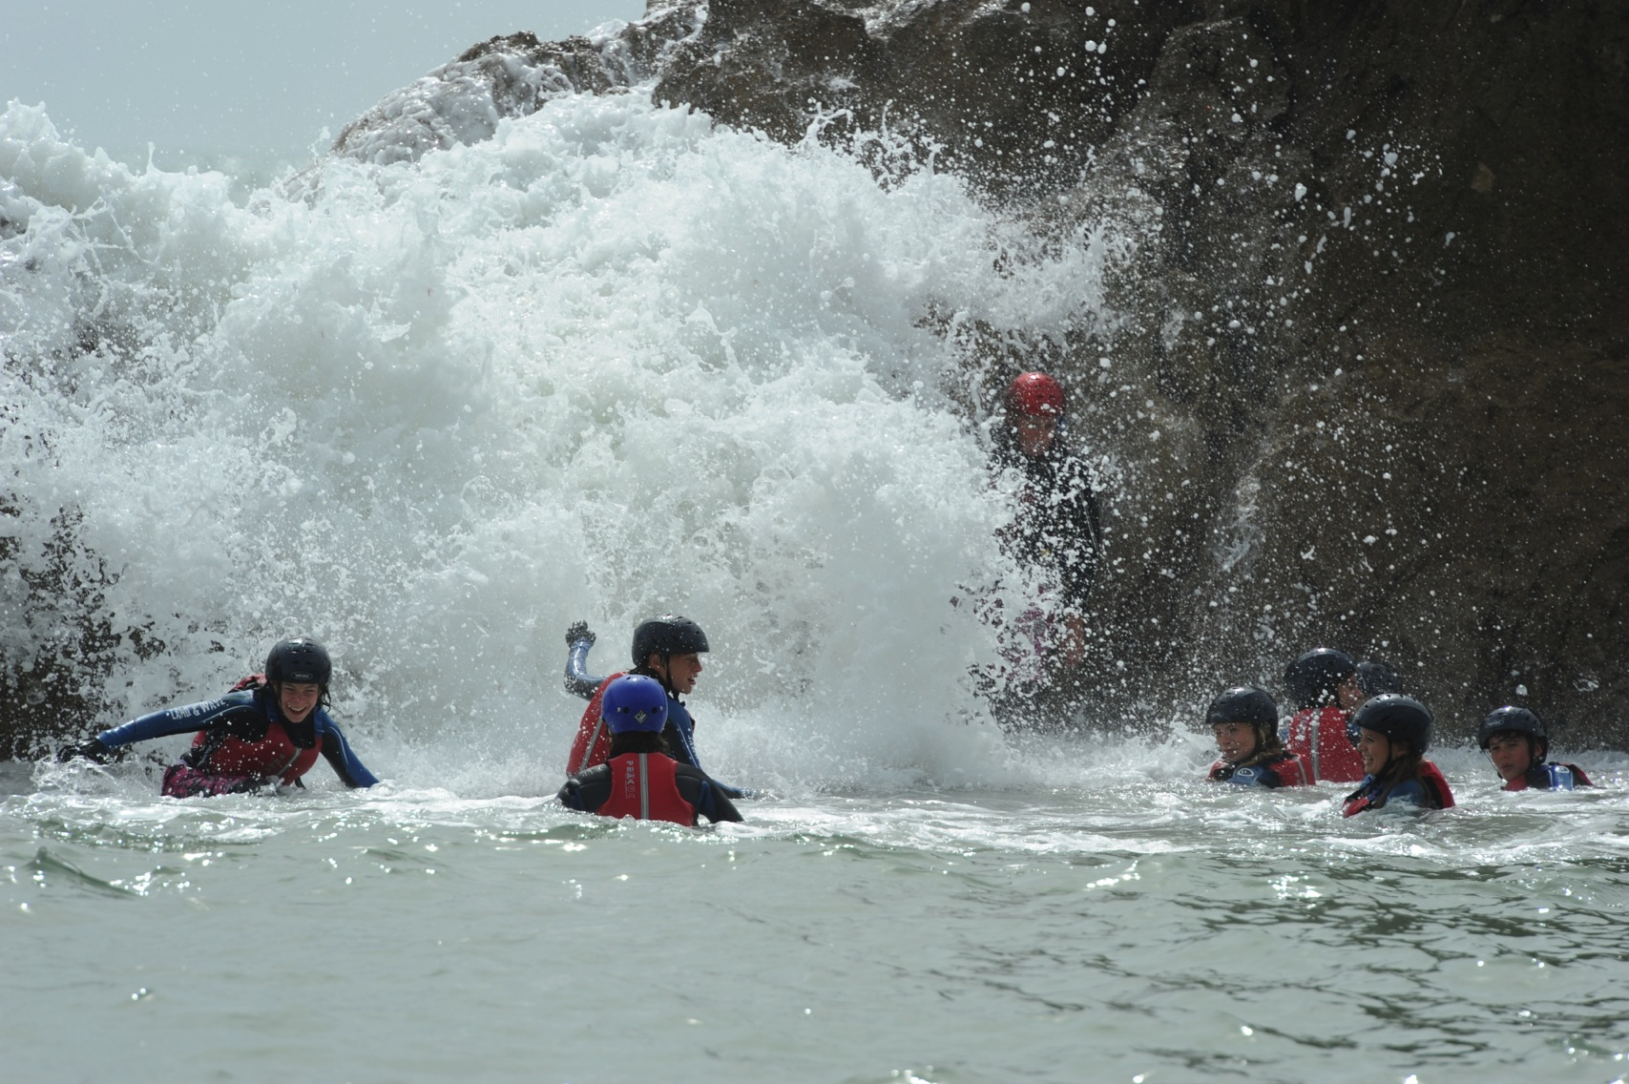
rempstone
adventure camp

Slide 7
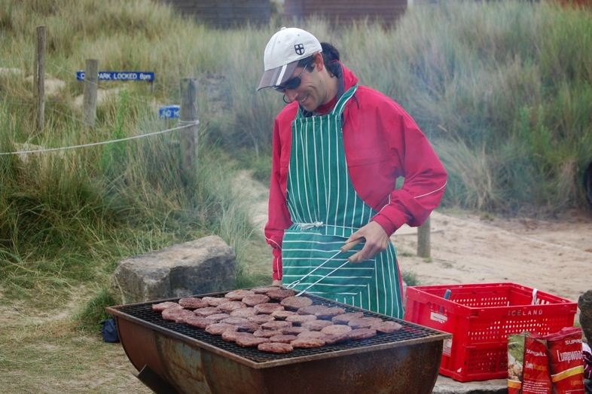
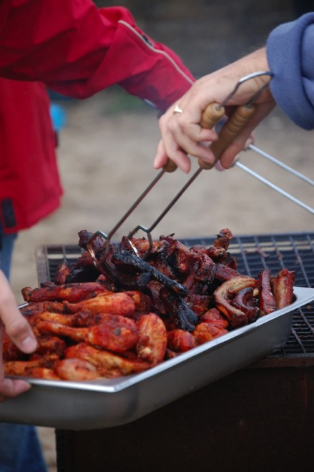
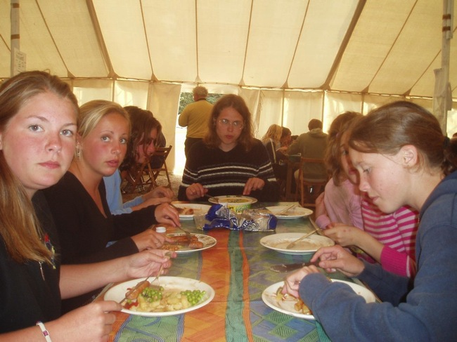
rempstone
adventure camp

Slide 8
rempstone
adventure camp
There are a few things we all do together but most days you will get a choice of different activities. Some will be energetic and adrenalin filled – others will be more chilled. It’s up to you.
Our food is legendary. You get a full on cooked breakfast, a decent packed lunch, a substantial two course supper and a bedtime snack. If you are still hungry there is a well stocked tuck shop.

Slide 9
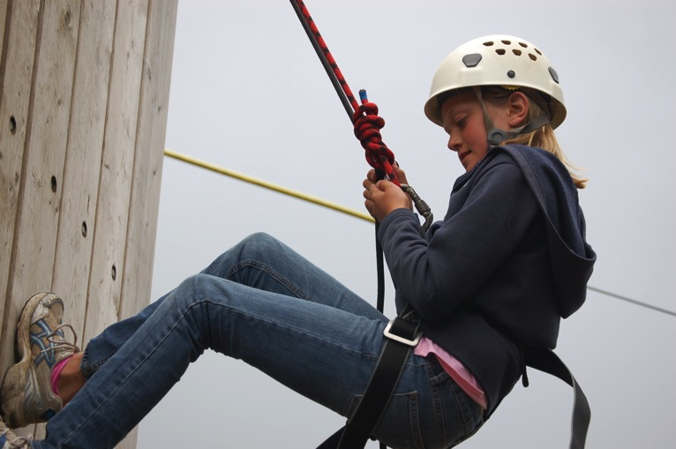
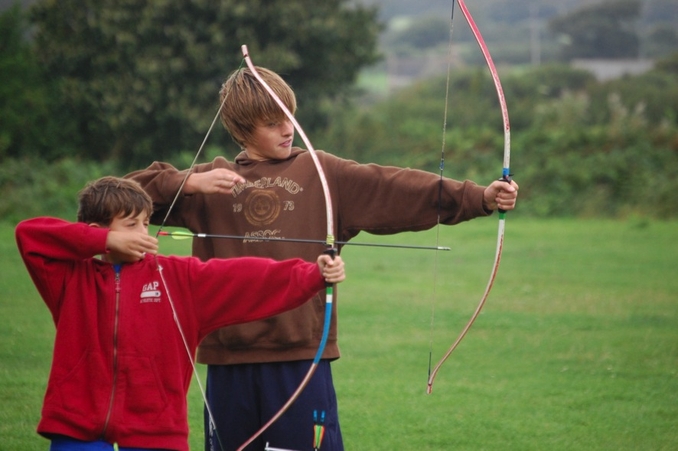
rempstone
adventure camp

Slide 10
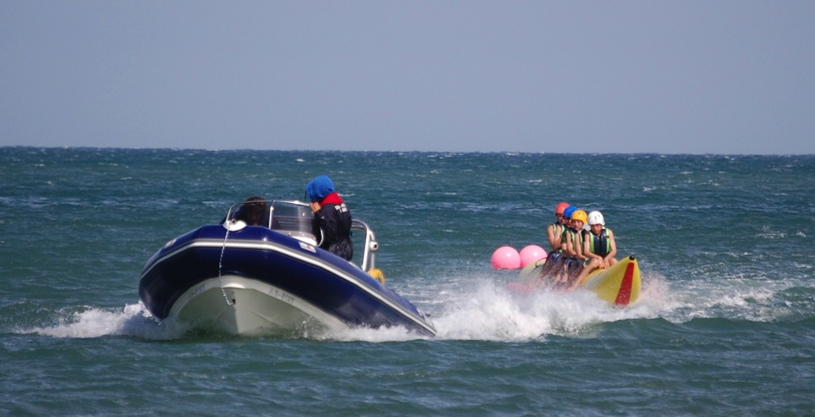
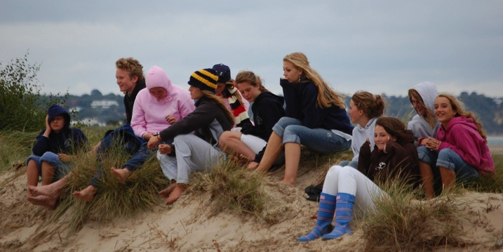
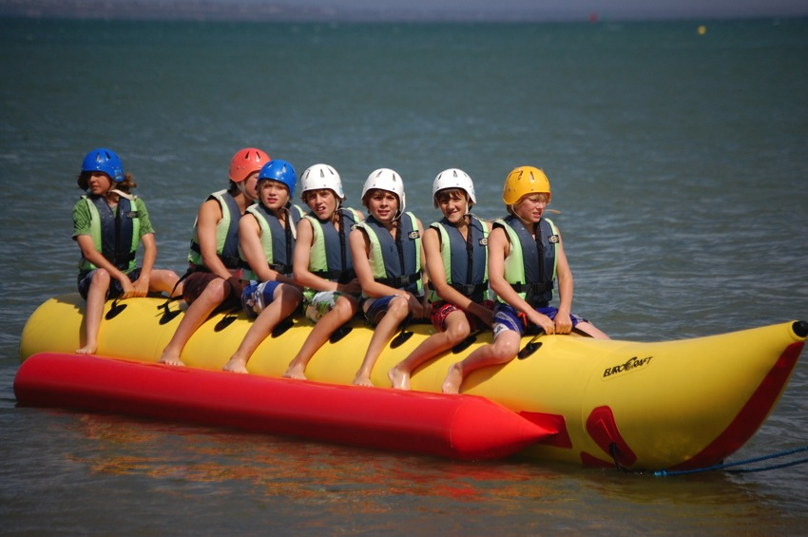
rempstone
adventure camp

Slide 11
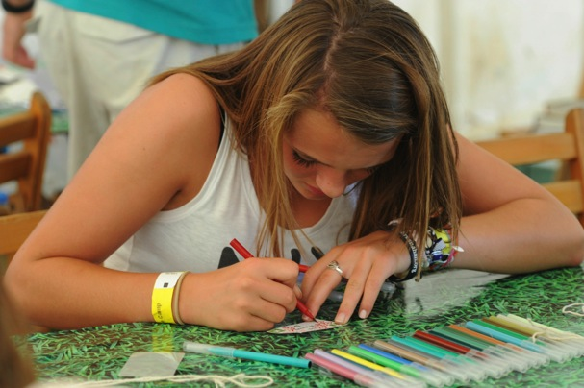
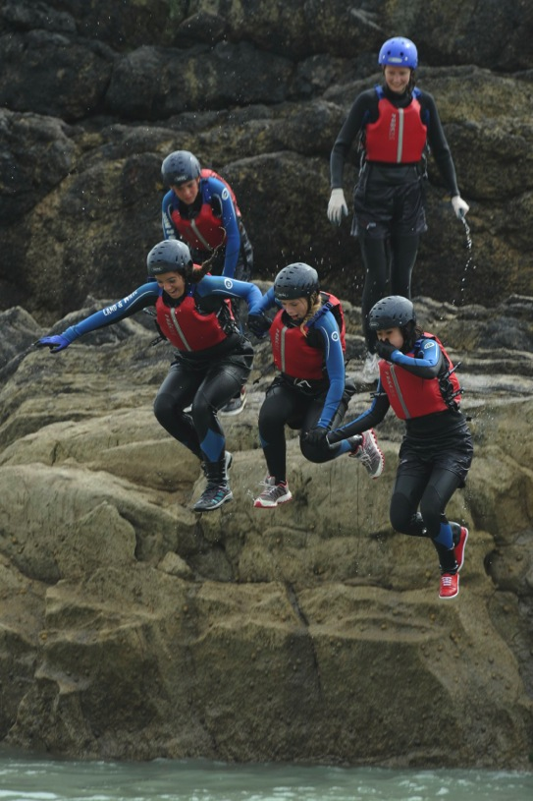
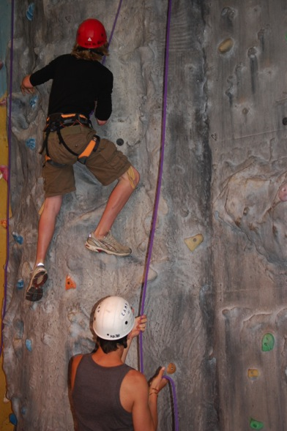
rempstone
adventure camp

Slide 12
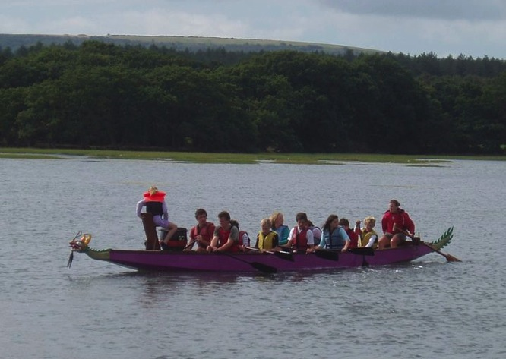
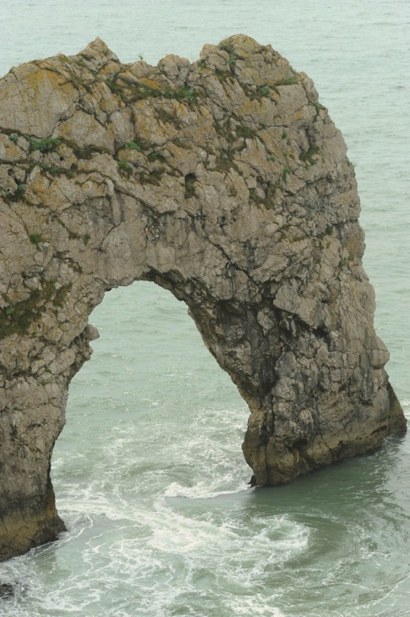
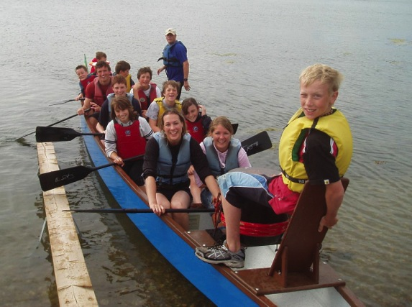
rempstone
adventure camp

Slide 13
rempstone
adventure camp
A
Archery, Abseiling
B
Beach Games, Banana Rides, Badminton
C
Climbing, Coasteering, Crocker, Crafts
D
Dragon Boats, Drama, Durdle Door
E
Entertainment (Radio Rempstone Roadshow)

Slide 14
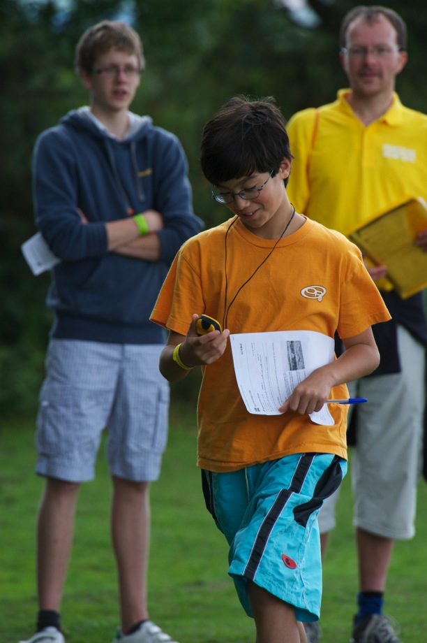
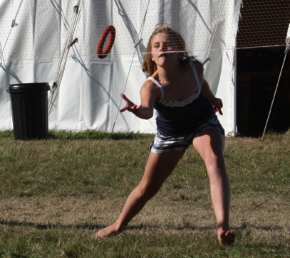
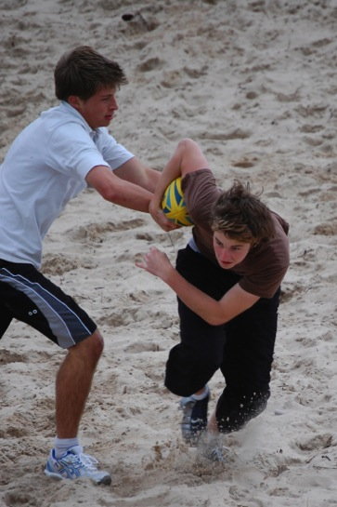
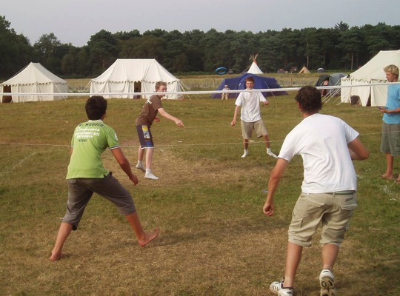
rempstone
adventure camp

Slide 15
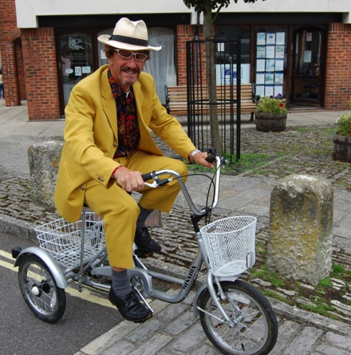
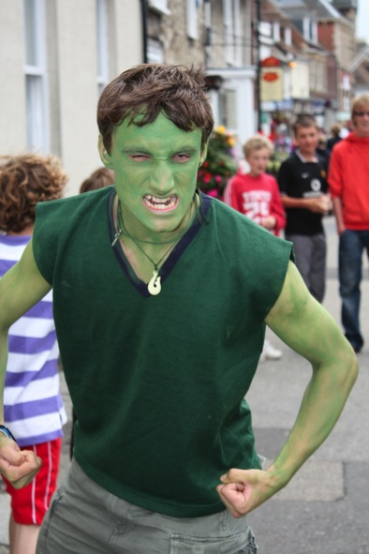
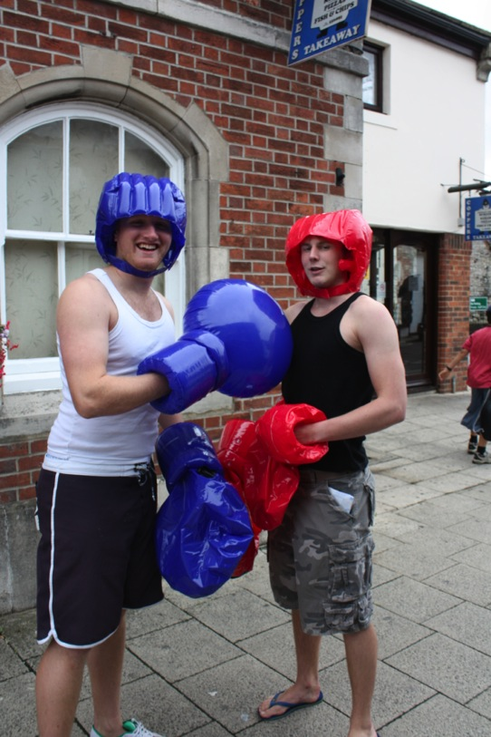
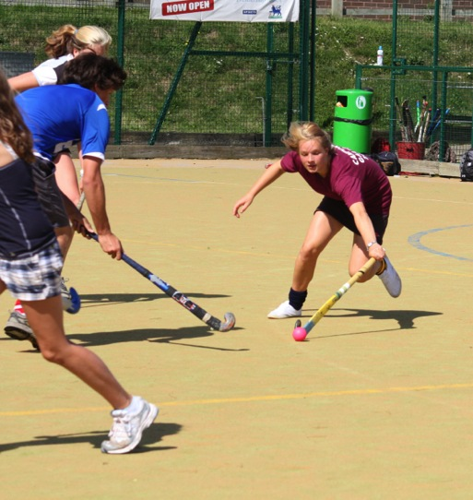
rempstone
adventure camp

Slide 16
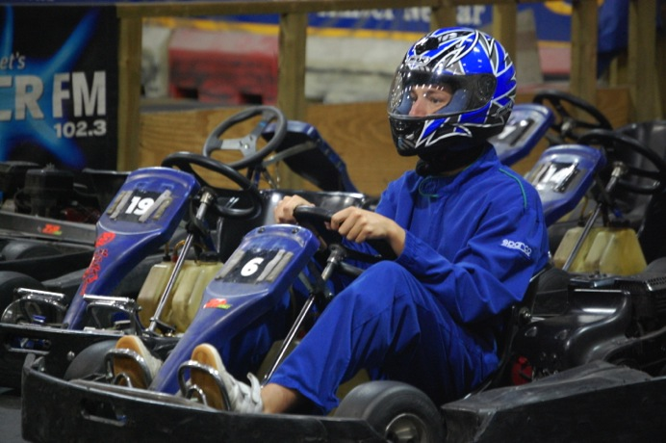
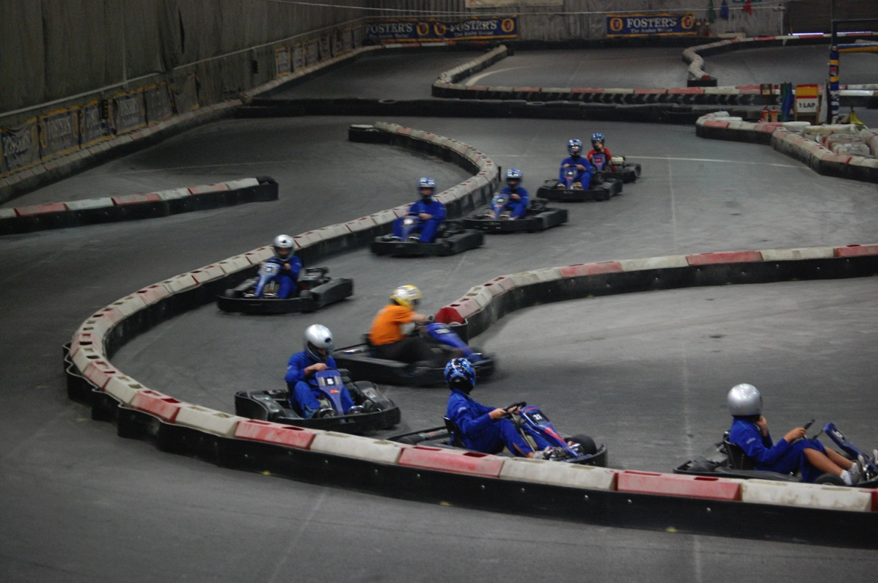
rempstone
adventure camp

Slide 17
rempstone
adventure camp
F
Friends, Forceball, Food, Football
G
Geocaching, Golf Range
H
Halo, ‘Hunt the Leader’, Hockey
I
Indoor Karting
J
Junior Leaders

Slide 18
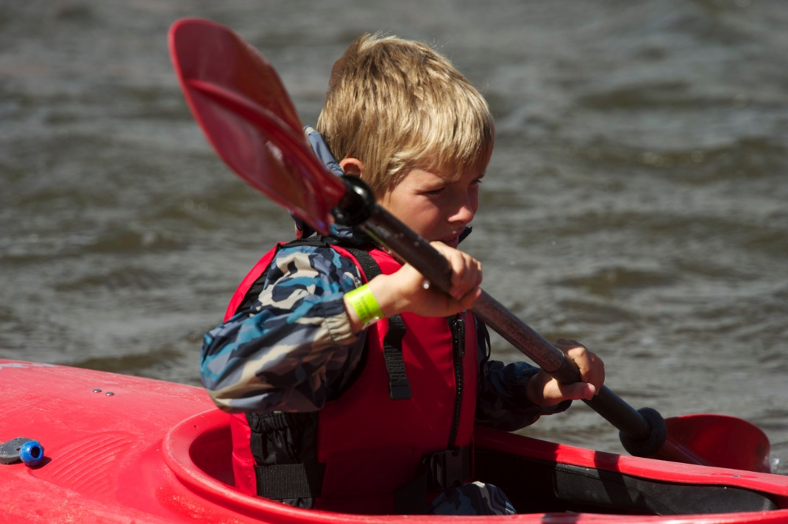
rempstone
adventure camp

Slide 19
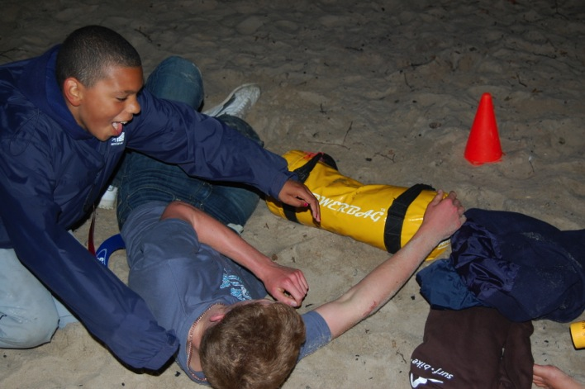
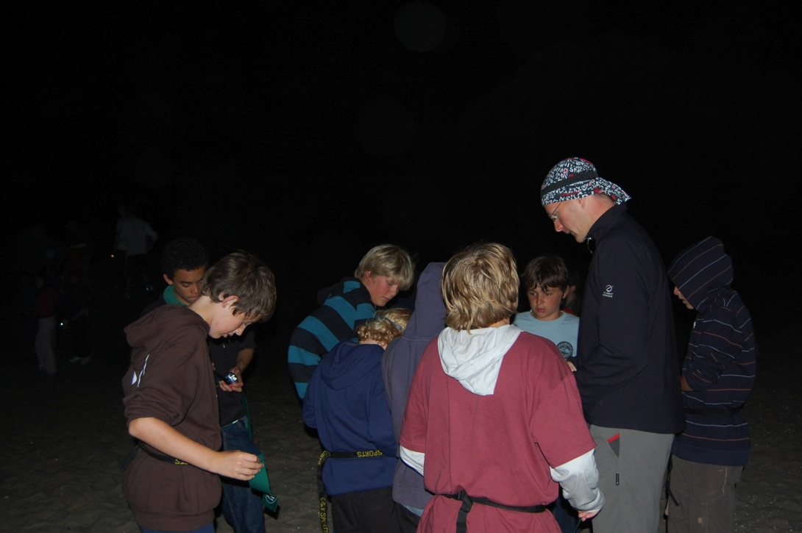
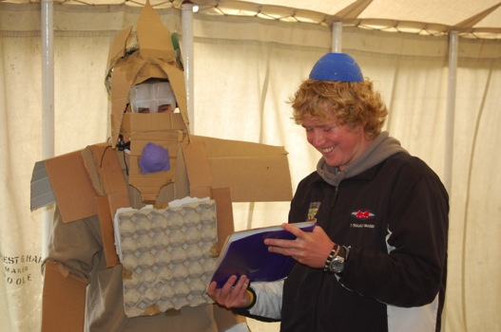
rempstone
adventure camp

Slide 20
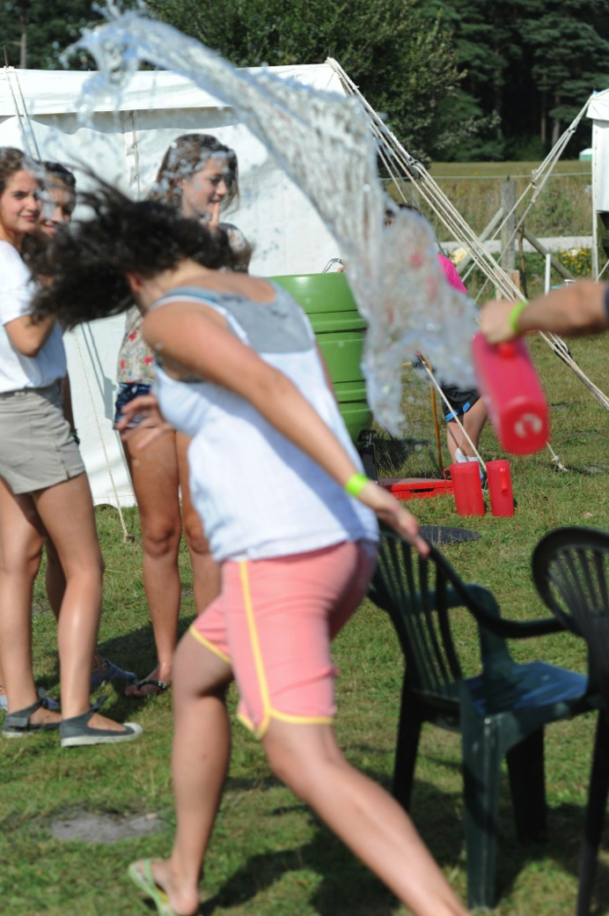
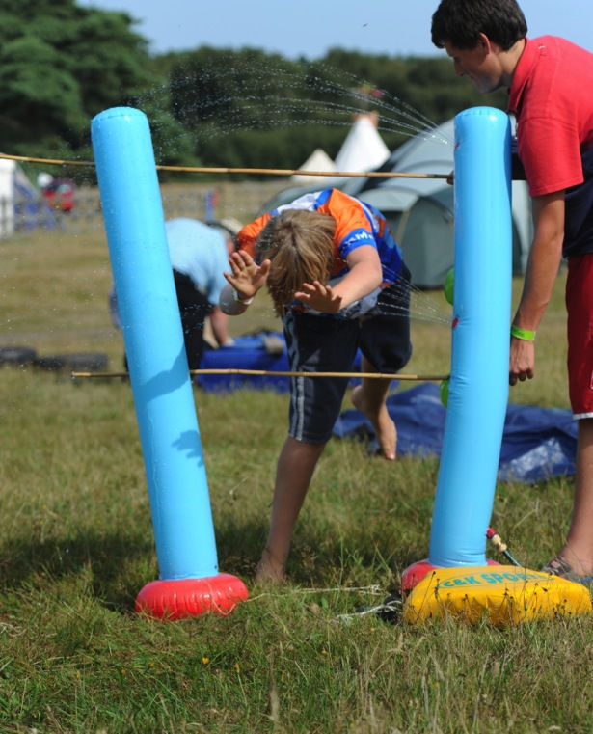
rempstone
adventure camp

Slide 21
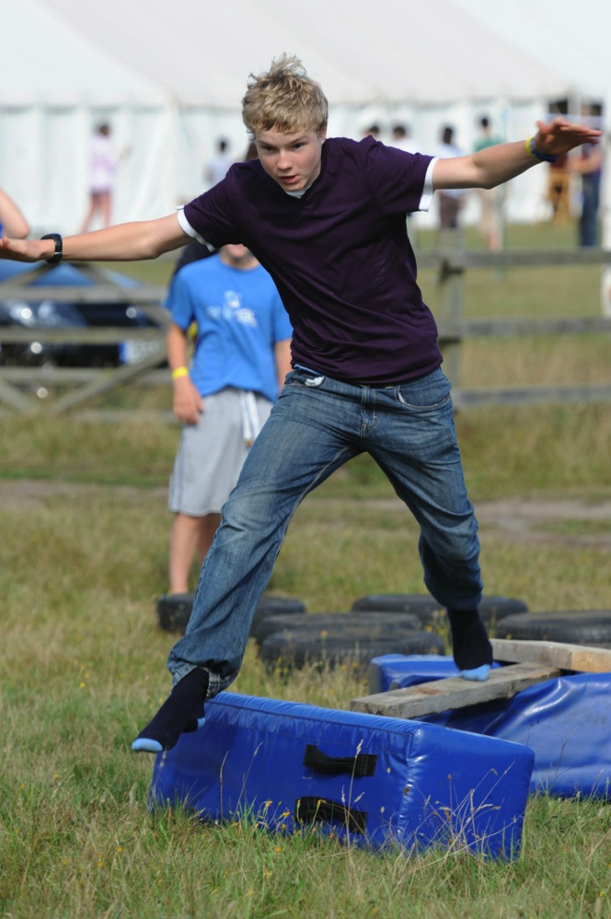
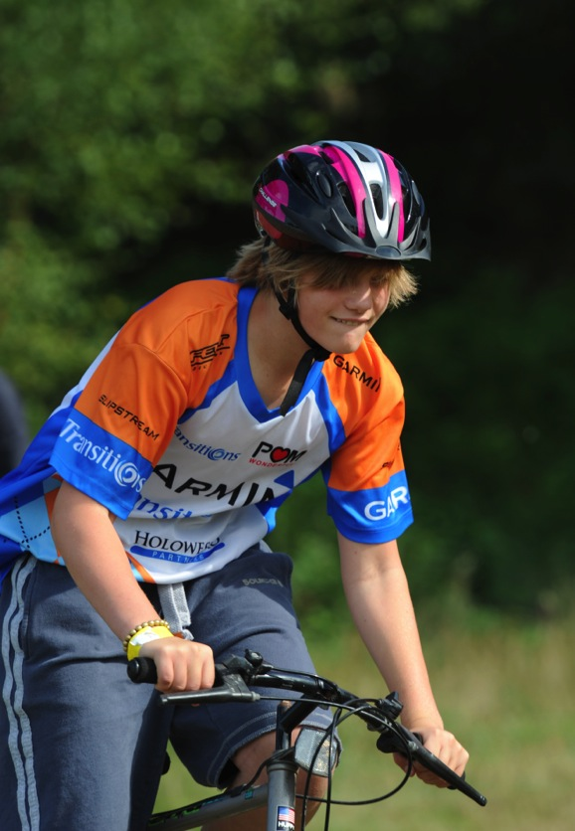
rempstone
adventure camp

Slide 22
rempstone
adventure camp
K
Kayaking, Kimmeridge
L
Longball, Lulworth
M
Maneuver, Mountain Biking, Marquee
N
Night Wide Game, ‘NGOOT’, Night Walk
O
Orienteering

Slide 23
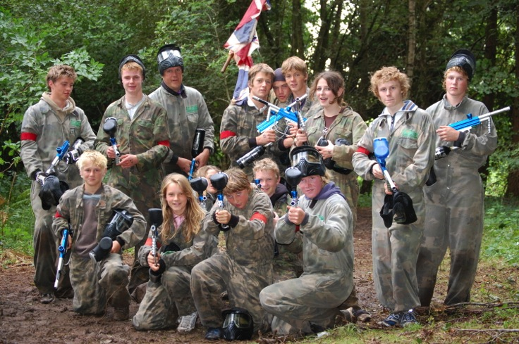
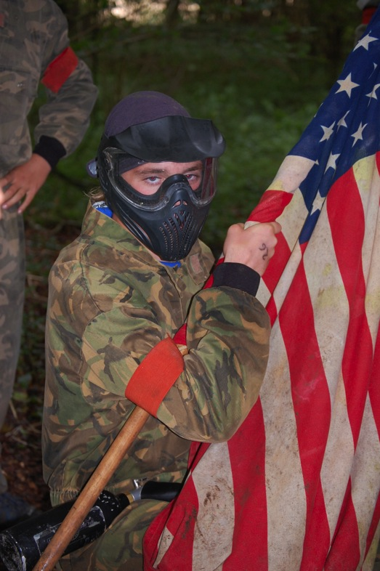
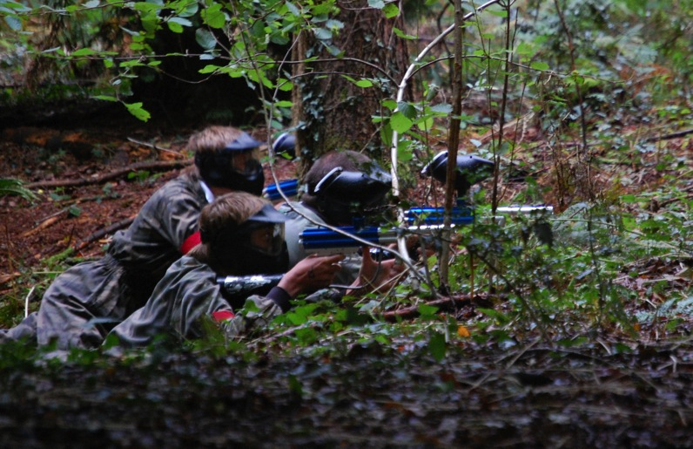
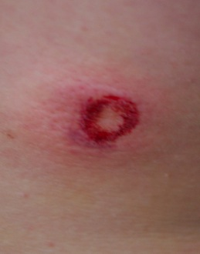
rempstone
adventure camp

Slide 24
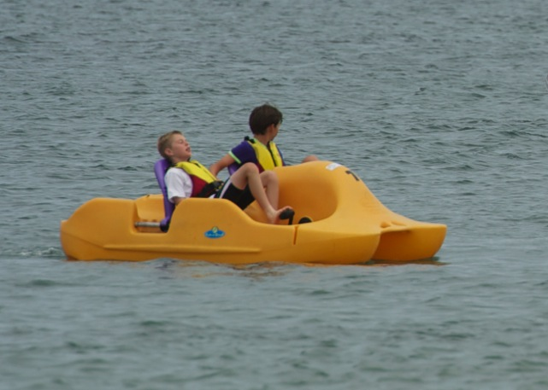
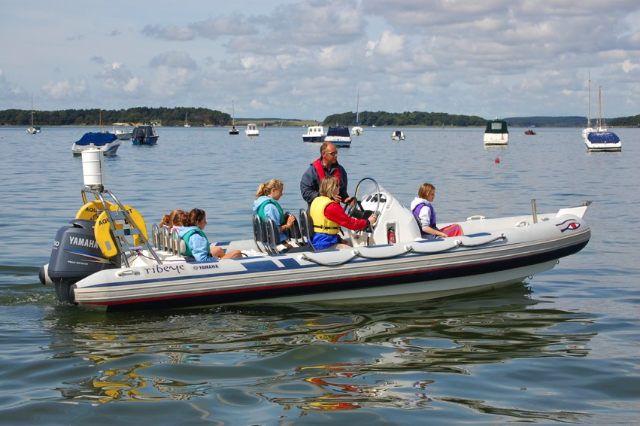
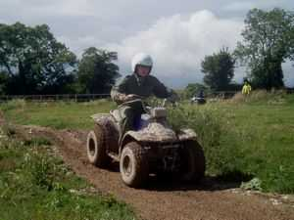
rempstone
adventure camp

Slide 25
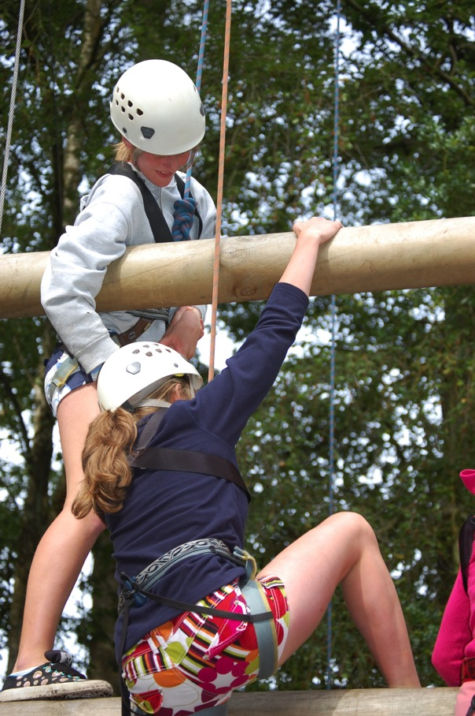
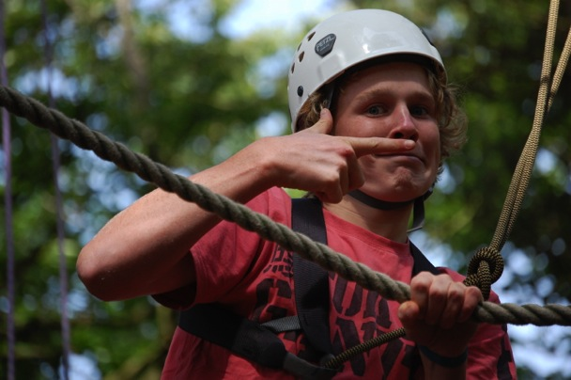
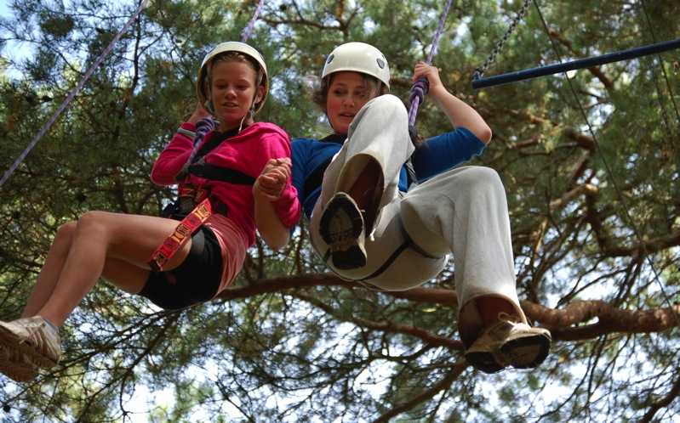
rempstone
adventure camp

Slide 26
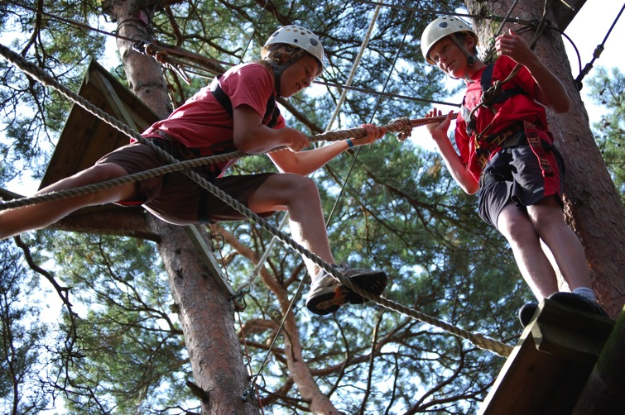
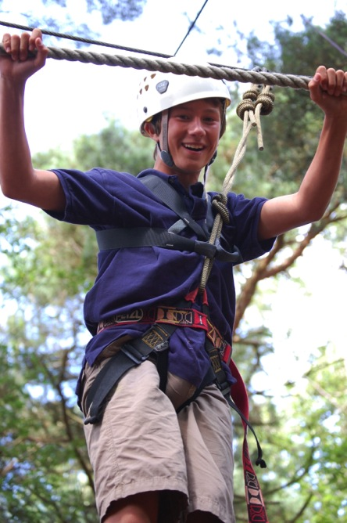
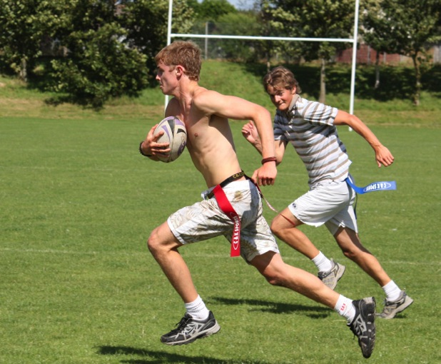
rempstone
adventure camp

Slide 27
rempstone
adventure camp

Slide 28
rempstone
adventure camp

Slide 29
rempstone
adventure camp

Slide 30
rempstone
adventure camp
P
Paintball, Prayers, Pedaloes
Q
Quad Bikes, Quiet Times
R
RIB Driving, Ropes Course, Rugby
S
‘Survive’, Sailing, Sea Fishing, Shooting
T
Tents, Tanks, Tent Leaders, Tunnelling

Slide 31
rempstone
adventure camp

Slide 32
rempstone
adventure camp

Slide 33
rempstone
adventure camp
U
Ultimate Frisbee
V
Volleyball, Virtual Warfare
W
Wind-surfing, Water-skiing
X
X-Country (The Rempstone Relay)
Y
You?
Z
Zorbs (possible new activity for 2016)

Slide 34
rempstone
adventure camp

Slide 35
rempstone
adventure camp
As well as providing an exceptional range of activities, the purpose of our holidays is to give those who attend the opportunity to explore the Christian faith. We do that by getting one of our leaders to give a very short presentation at the end of breakfast to give us a thought-provoking start to the day. In the evening we hold a meeting where our live band leads some lively singing and then one of the leaders speaks briefly or leads a discussion. There is an opportunity to extend this discussion for a few minutes in tent groups at what we call Quiet Time.

Slide 36
rempstone
adventure camp

Slide 37
rempstone
adventure camp
What Next?
If you are interested then ask for a leaflet which gives you the information you and your parents need including dates (17th to 27th August) and the cost.
It also gives a link to the online booking system on our website.
www.rempstoneadventurecamp.org.uk

